Slide 1
5월 4주차 업무보고
- 홍채추적 Open API 조사
류경준

Slide 2
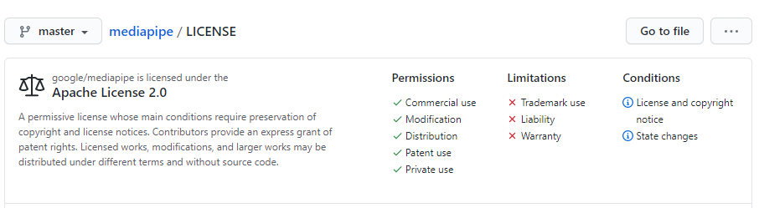
01.
Open API
Google, mediapipe
[LICENSE]
[model]

Slide 3
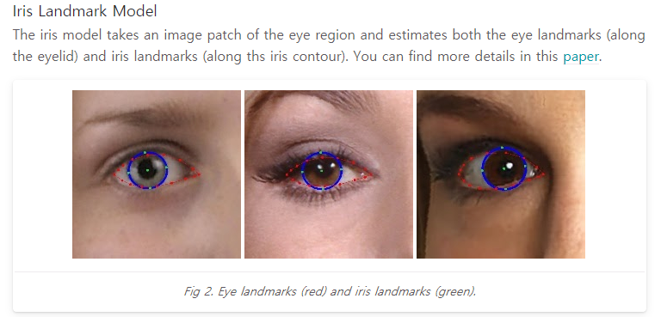
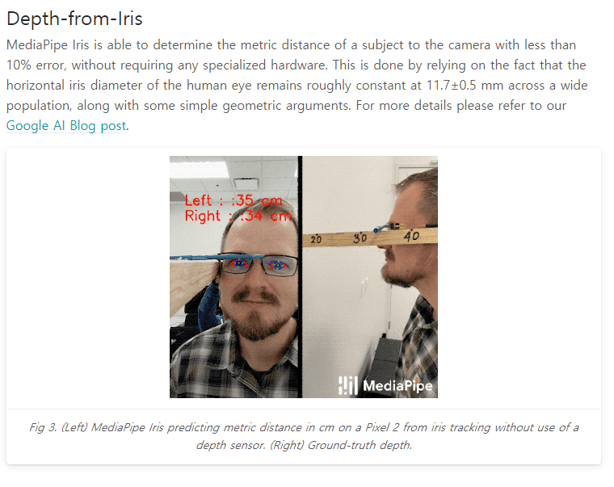
01.
Open API
Google, mediapipe
[Iris Tracking 설명]
https://google.github.io/mediapipe/solutions/iris
[DEMO]
https://viz.mediapipe.dev/demo/iris_tracking

